Slide 1
Course Code:CSE-3104
Course Title :Software Engineering Laboratory
Project Title: Movie And Show Booking Website .

Slide 2

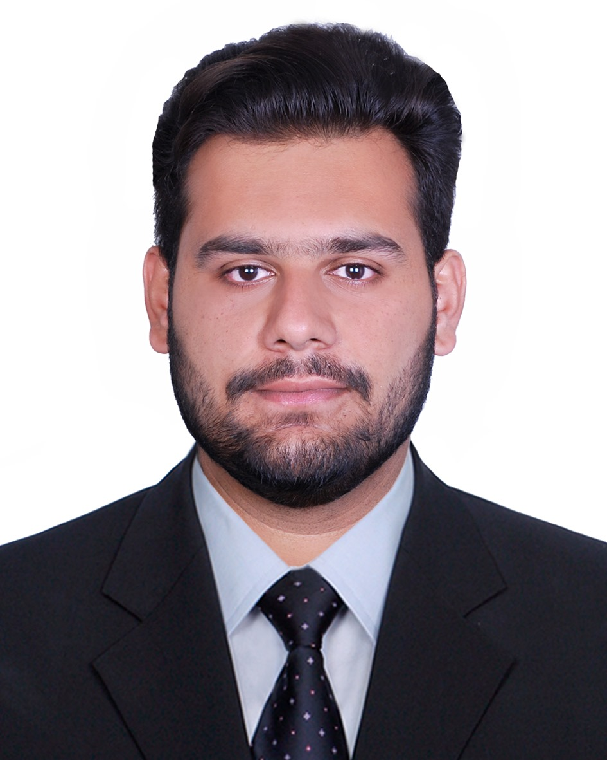
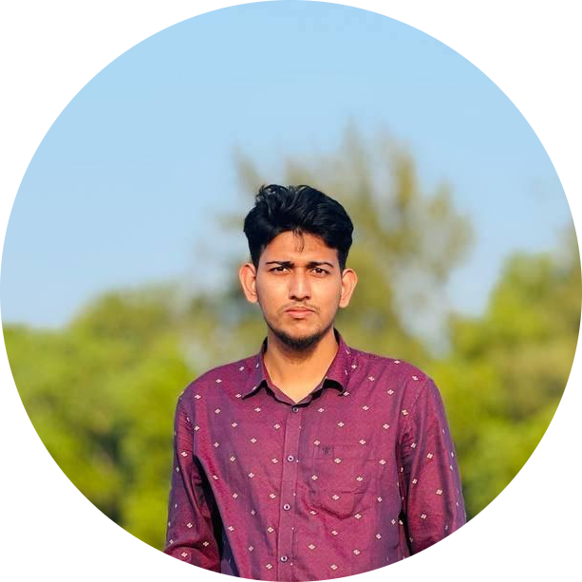
Group Member
G.M Asif Foisal
ID: 20232057010
Md. Waleullah
ID: 20232046010
Sarder Shamsul Arefin Shawon
ID: 20232050010

Slide 3
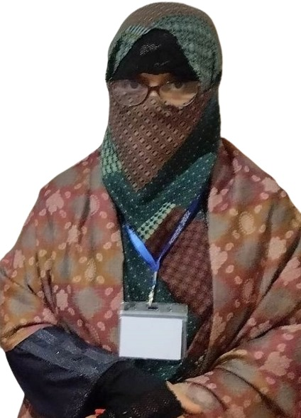
Guided BY:
Zahrul Jannat Peya
Assistant Professor
Department of Computer Science and engineering
North Western University , Khulna

Slide 4
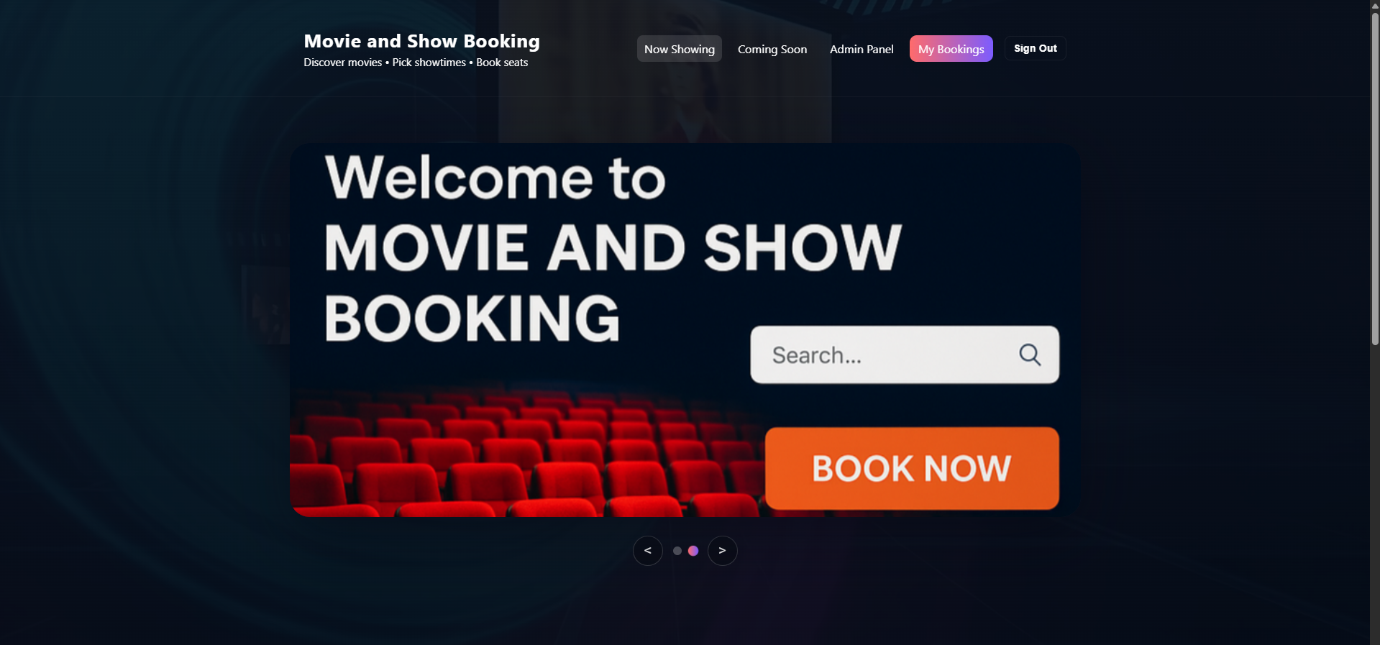
Welcome message

Slide 5
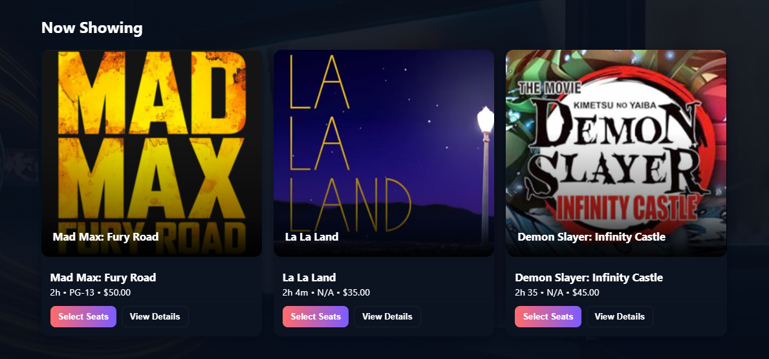
Now Showing

Slide 6
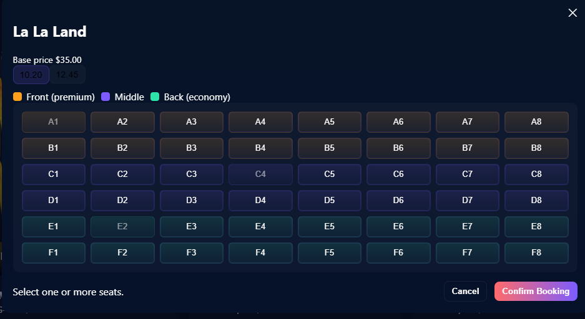
Select Seat

Slide 7
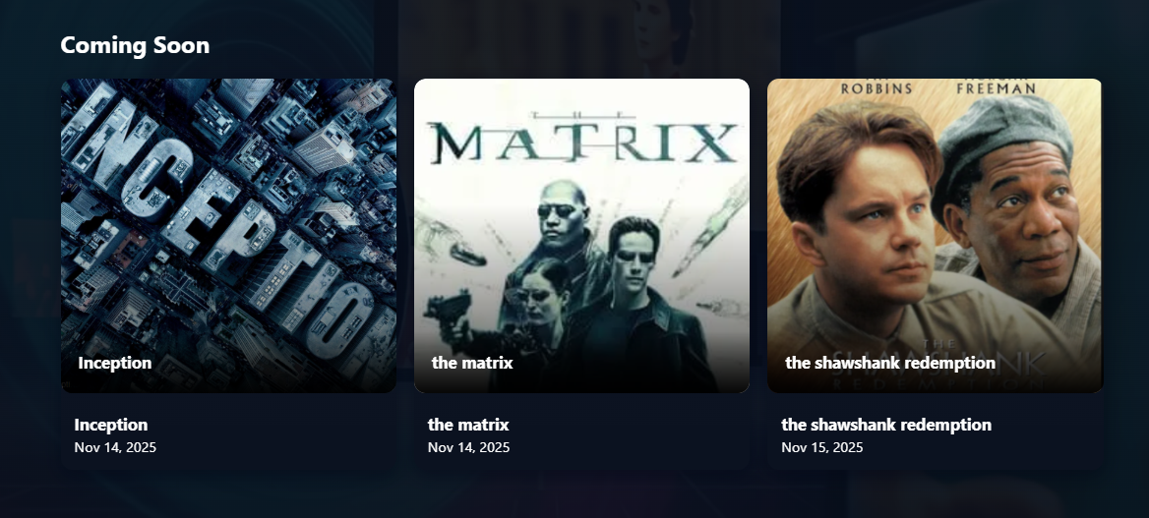
Upcoming

Slide 8
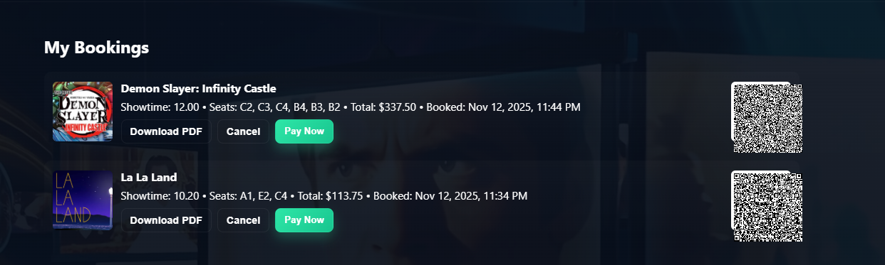
My Booking

Slide 9
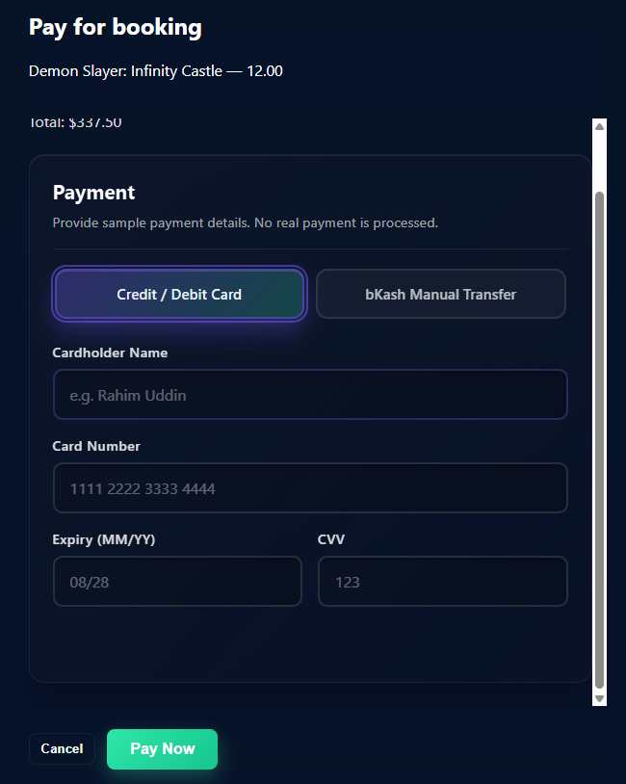
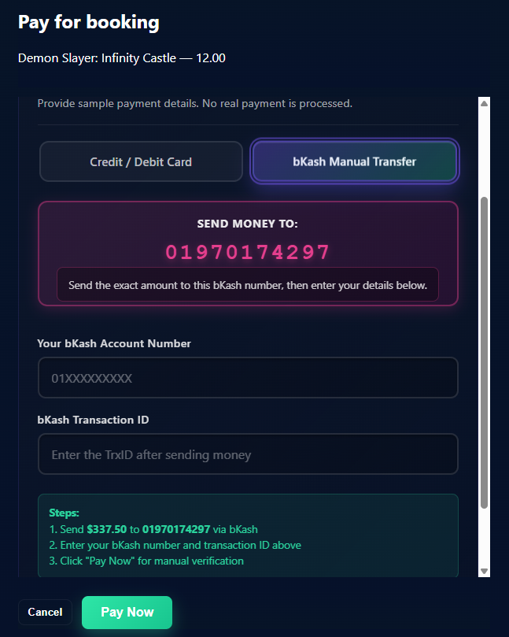
Payment Option

Slide 10
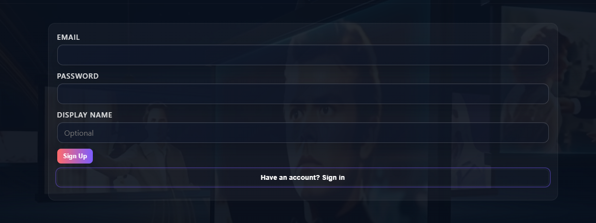
Login And Sign Up

Slide 11
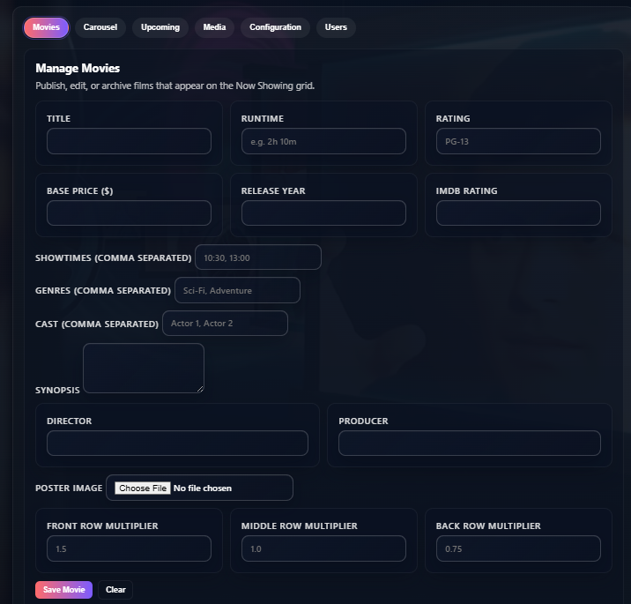
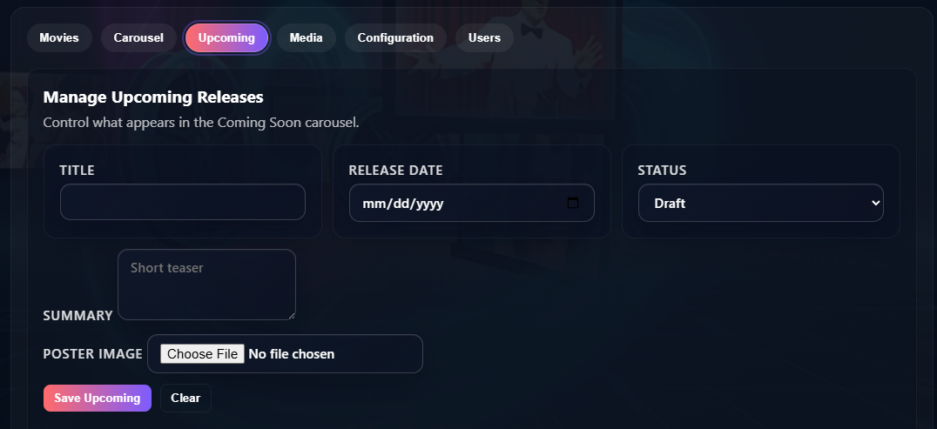
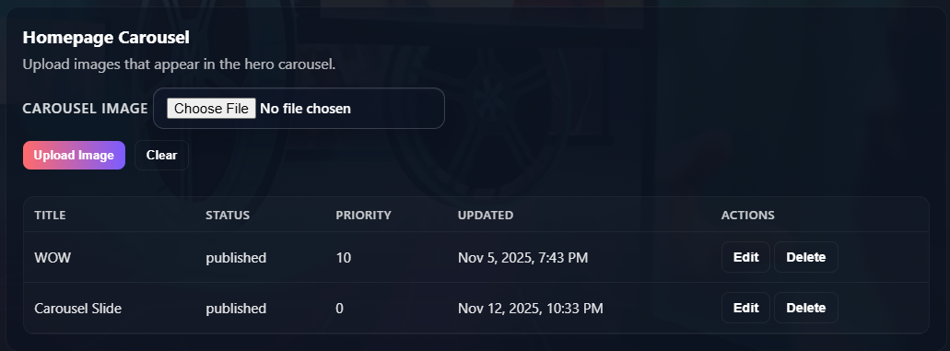
Admin Panel

Slide 12
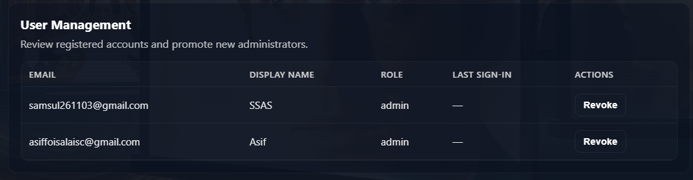

Slide 13


